Slide 1


Slide 2
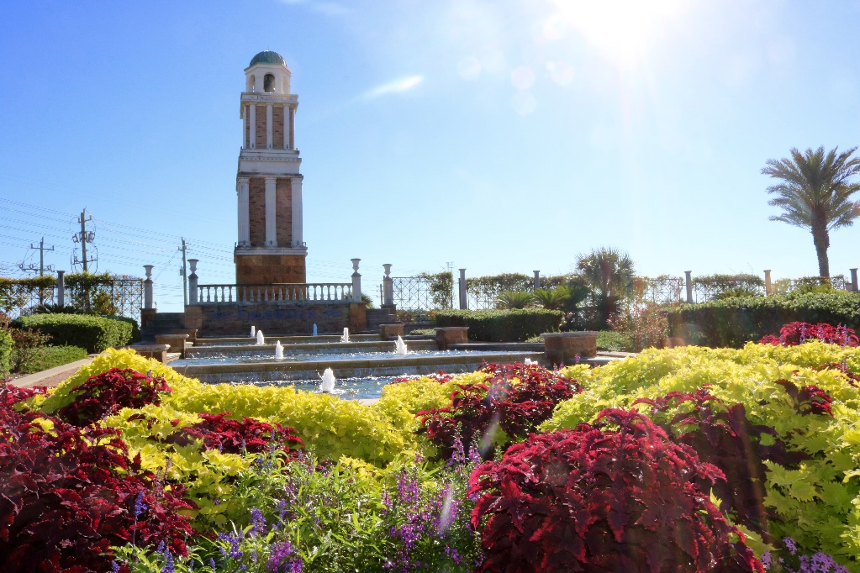
Local Decisions
have created Texas cities where people want to
Live

Slide 3
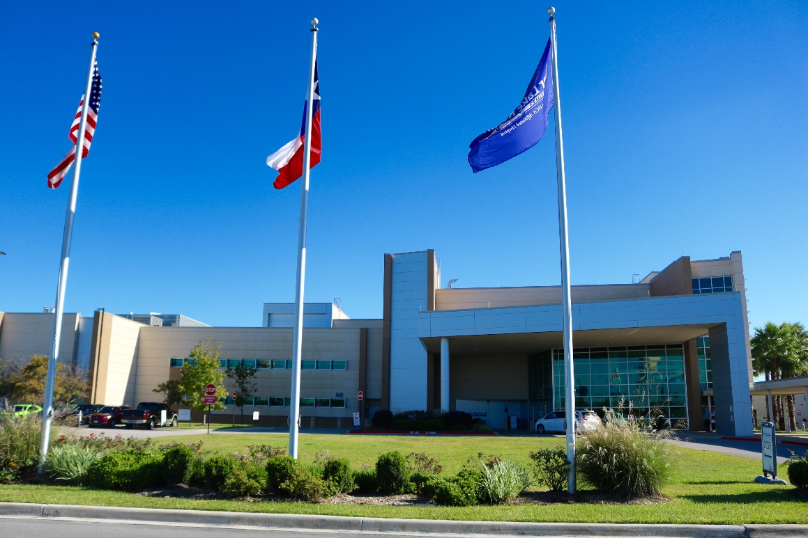
Local Decisions
have created Texas cities where people want to
Live
Work

Slide 4
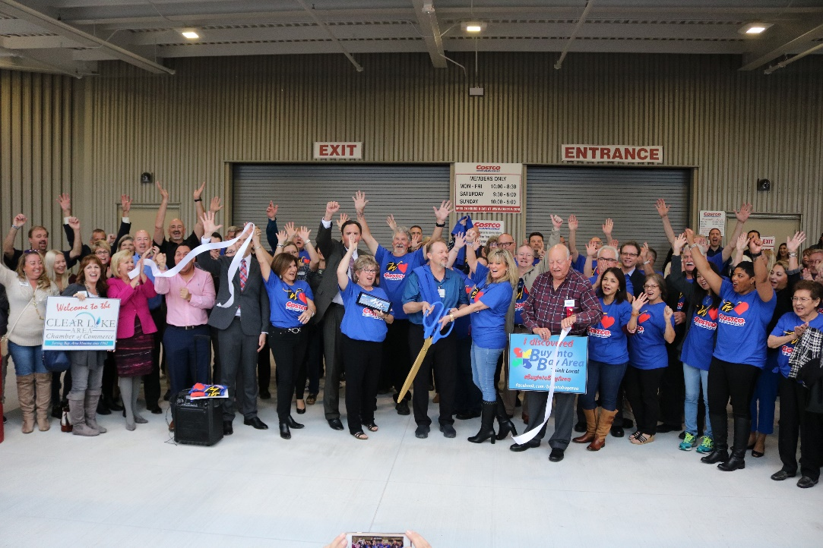
Local Decisions
have created Texas cities where people want to
Live
Work
Do business

Slide 5
Fastest Growing Cities in U.S.
#1 Frisco, TX
#5 Midland, TX
#6 McKinney, TX
#9 Austin, TX
Year after year, Texas cities rank among the top cities in the nation for job creation, population growth and best management.
Most Efficient Public Spending
#5 Houston, TX
#7 Dallas, TX
#14 El Paso, TX
#16 Austin, TX
#20 Lubbock, TX
Best Places to Start a Business
#2 Austin, TX
#18 Laredo, TX
#20 Fort Worth, TX

Slide 6


Texas cities lead the nation because they provide the services and infrastructure businesses need and the quality of life people want.

Slide 7
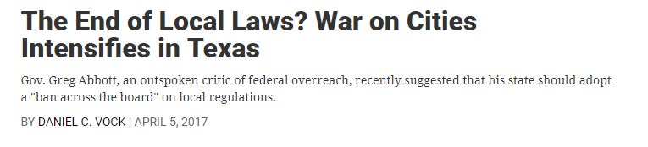
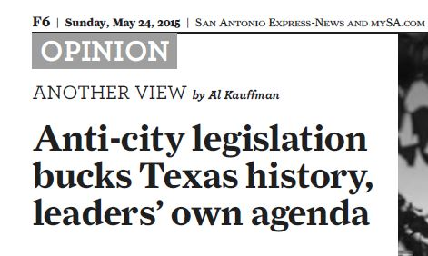
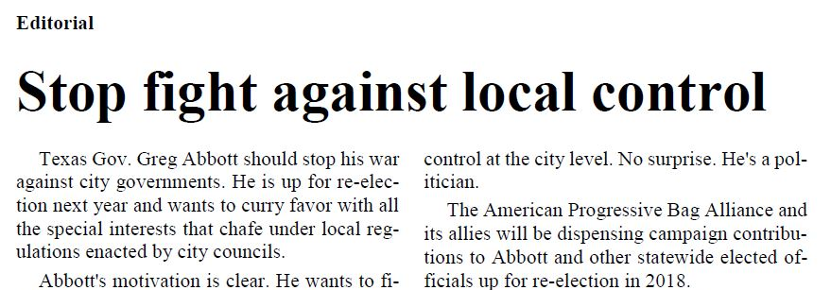
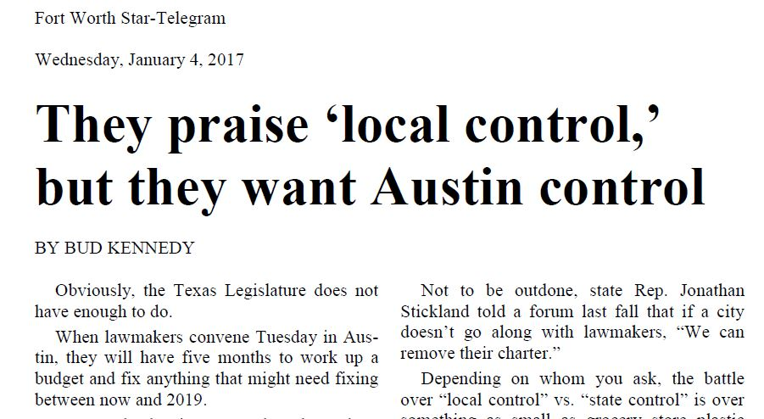
Instead of celebrating the amazing successes of Texas cities, some state officials are telling the world that Texas cities are bad places to do business.

Slide 8
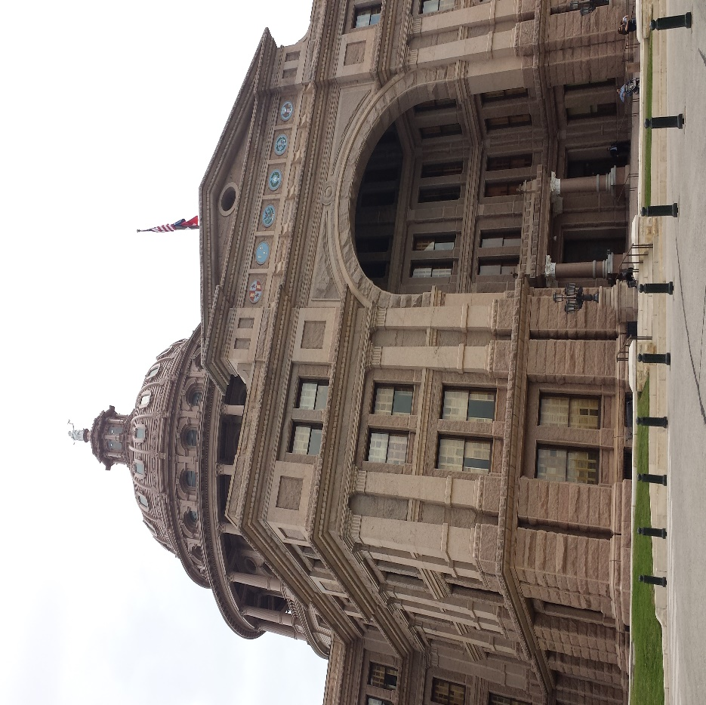
The ability of Texans to create vibrant, livable cities is under assault from state officials who want to dictate that every community and neighborhood conform to their agenda.

Slide 9
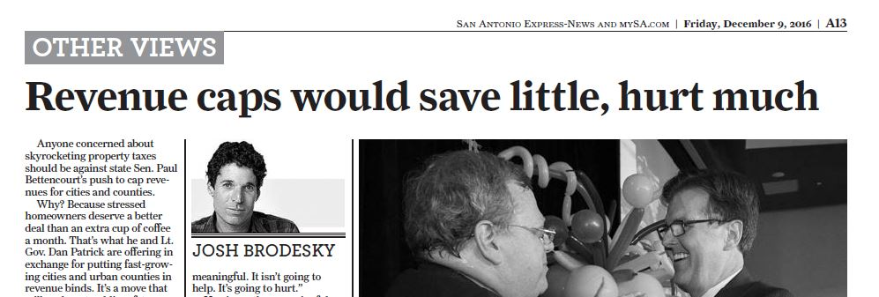
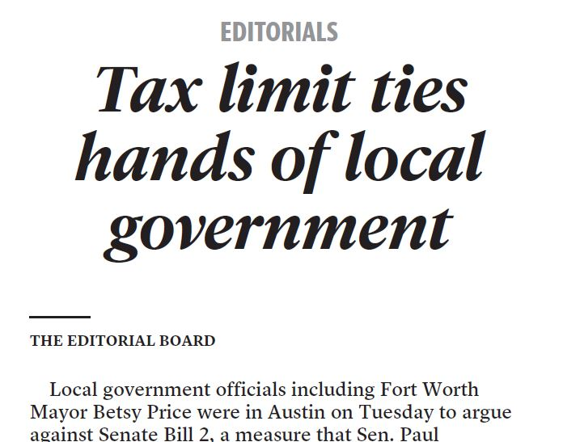
State officials want to put one-size-fits-all restrictions on the annual budgets of all cities and counties.

Slide 10
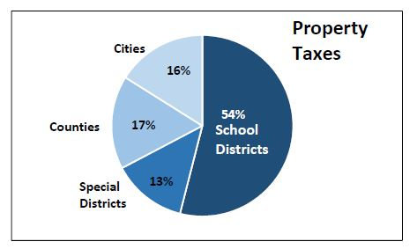
Some state officials are trying to mislead Texans into believing cities are to blame for high property taxes.
But here’s the truth:
Cities only collect 16% of property taxes.

Slide 11
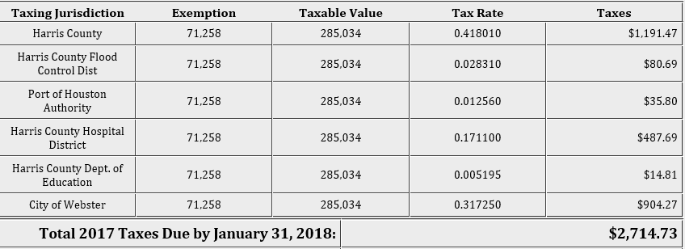
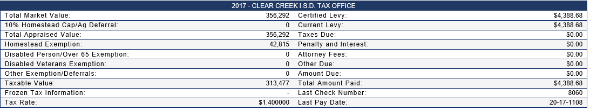
Look at your tax bill.
In Webster, school district taxes are almost 5 times higher than city taxes.

Slide 12
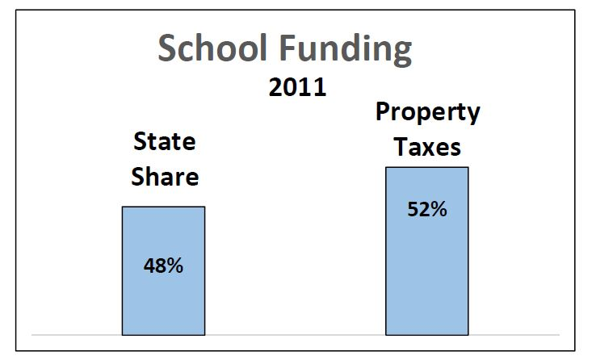
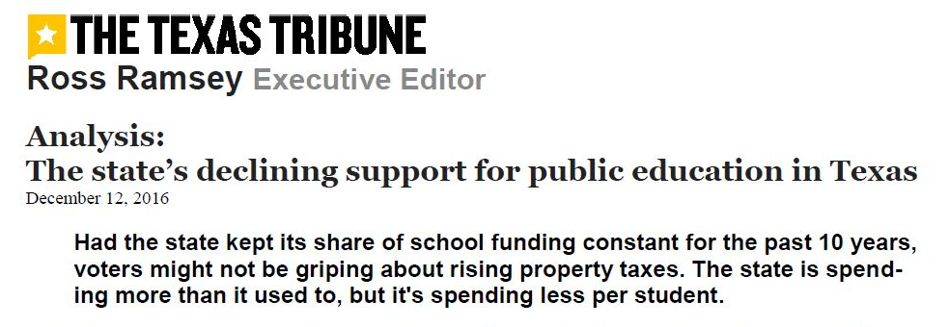
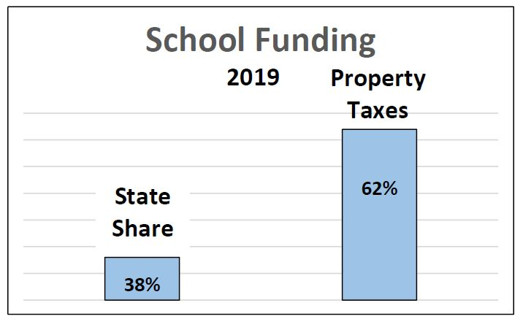
Texas property taxes are high because the legislature has been cutting the state’s share of funding for education.
This forces school districts to raise your local property taxes to make up the difference.

Slide 13
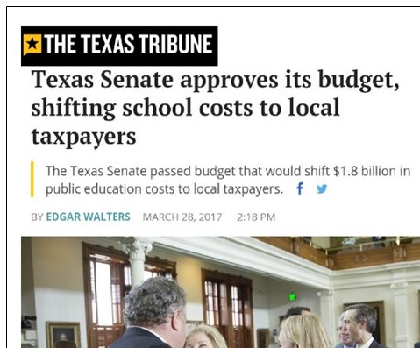
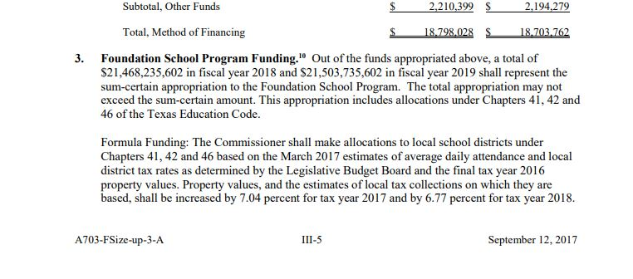
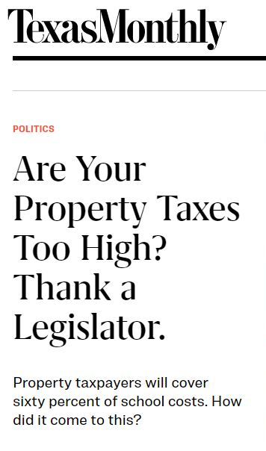
Senate Bill 1 – General Appropriations Bill FY 2018 – FY 2019
In 2017, the Legislature adopted a state budget that is based on our school property taxes increasing by 14% over two years.

Slide 14
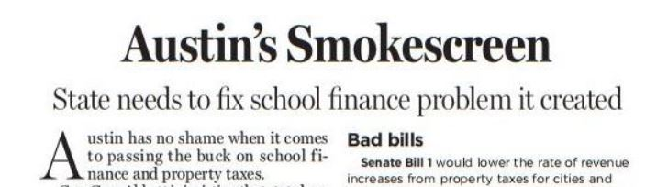
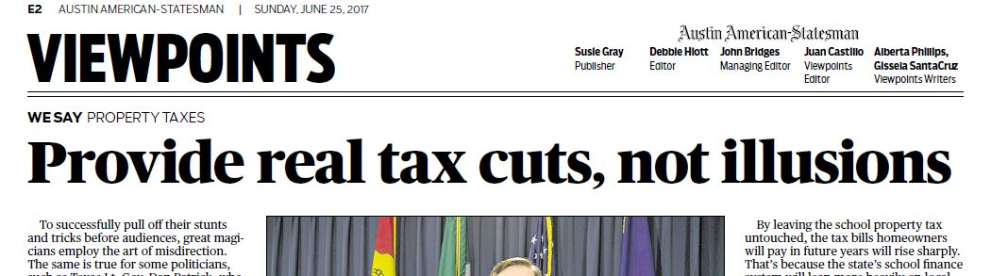
Instead of blaming cities, the state can provide meaningful property tax relief by fixing the school finance system.

Slide 15
We need to tell the real story:
Letting Texans decide at the local level what’s best for their community is the foundation of the Texas Miracle.

Slide 16
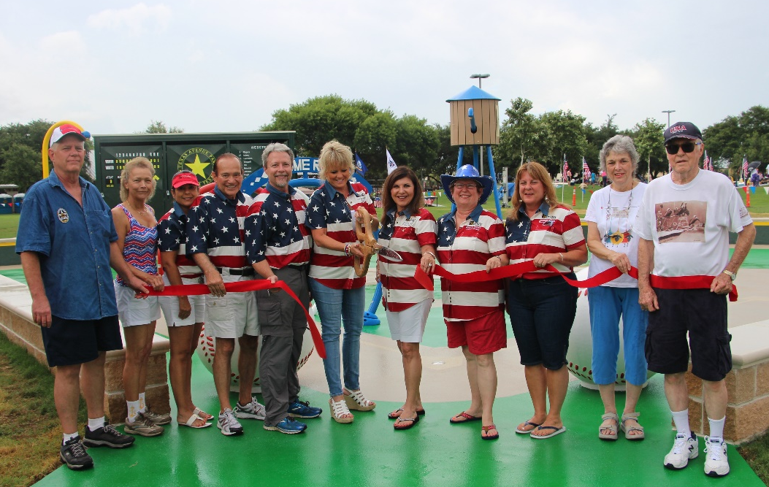
Local Decision-Making Gives Webster Residents a Voice
…in the level of services they want and how to pay for them

Slide 17
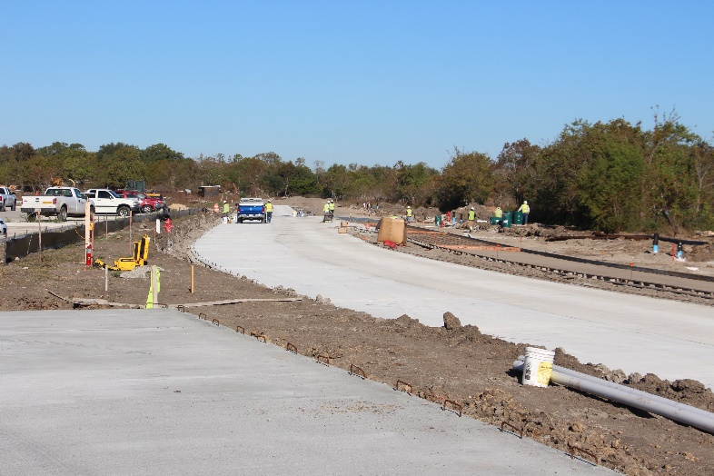
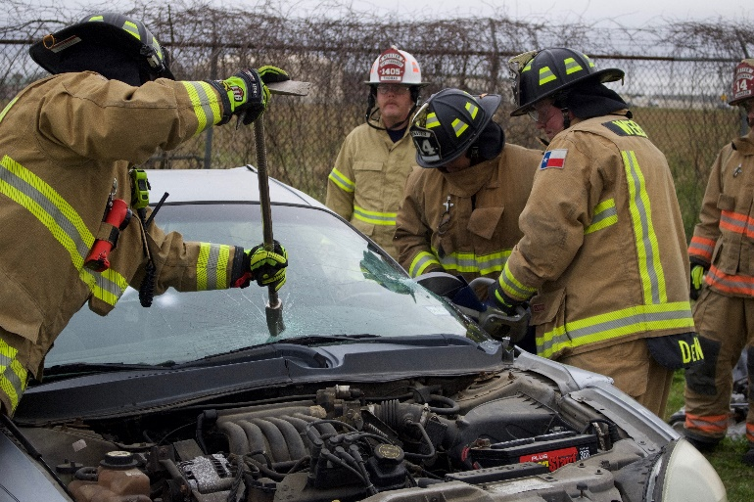
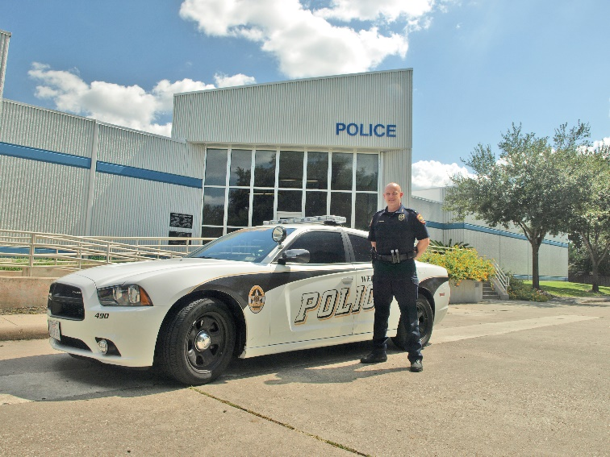
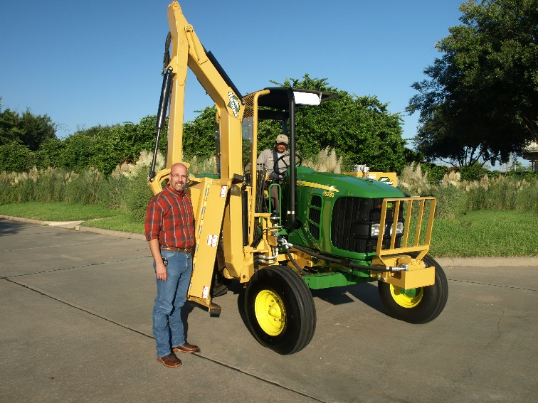
Local Decision-Making Gives Webster Residents a Voice
…in how much they want to invest in infrastructure improvements like roads, new police and fire stations, water and sewage treatment and recreation facilities.

Slide 18
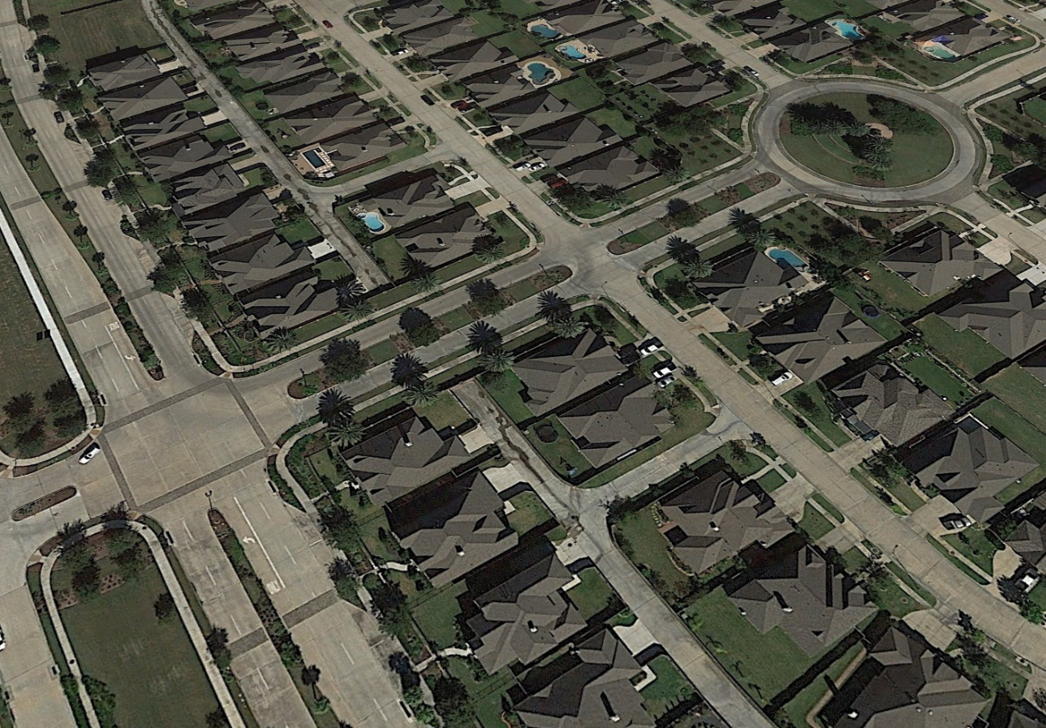
Local Decision-Making Gives Webster Residents a Voice
…in rules and regulations that protect their home values and the character of their neighborhoods.

Slide 19
Texans want the decisions that affect their homes and neighborhoods to reflect our local priorities and values.

Slide 20
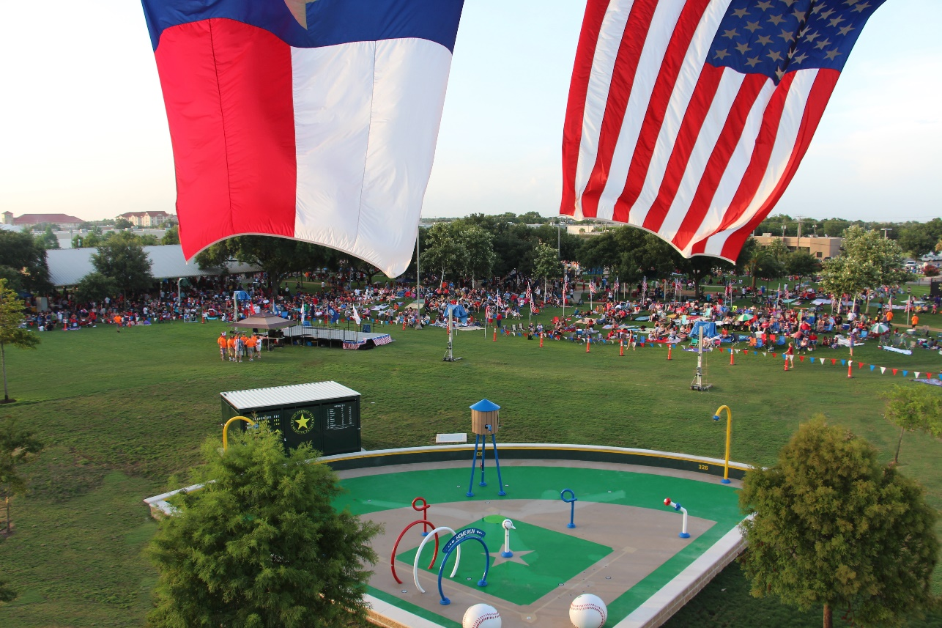
It’s your home.
It’s your neighborhood.
It’s your community.
You and your neighbors should decide what’s best for your community.

Slide 21
https://vimeo.com/287669117

